Slide 1
Pre-bond TSV Test Optimization
and Stacking Yield Improvement
of 3D ICs
Bei Zhang
Final Exam
Thesis Advisor: Dr. Vishwani Agrawal
Thesis Committee: Dr. Victor Nelson
Dr. Adit Singh
External reader: Dr. Xiao Qin
Department of Electrical and Computer Engineering
Auburn University, AL 36849 USA

Slide 2
ACKNOWLEGMENT
Prof. Vishwani Agrawal for his invaluable guidance throughout my work,
Prof. Adit Singh and Prof. Nelson for being my committee members and for their courses,
Prof. Xiao Qin for being my external reader,
My friends and family for their support throughout my research.

Slide 3
Presentation Outline
Introduction
Problem Statements
Prebond TSV test optimization
  Test session generation
  Dynamically identify faulty TSVs
  Test session scheduling
  Three-step test time optimization
Wafer-on-wafer stacking yield improvement and cost reduction
Conclusion

Slide 4
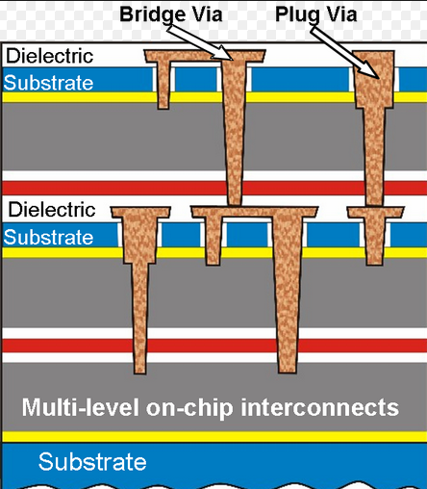
Introduction
3D stacked IC basic structure:
Through silicon
Via (TSV)

Slide 5
Introduction
RC models of defect-free pre-bond TSVs
Blind TSV type 1
Blind TSV type 2
Open-sleeve TSV

Slide 6
Introduction
Why test TSV before bonding?
Defects arises in TSV manufacturing, such as a void within a TSV, a complete break in a TSV, a pinhole creating a leakage path between TSV and substrate, etc.
Pre-bond TSV test helps identify defective dies early in the process and avoid situations where one single bad die causes entire 3D stack to be discarded.
Pre-bond TSV test provides known good die (KGD) information for die-to-die or die-to-wafer or wafer-on-wafer fabrication process.
Notes:
Heterogeneous integration means each layer can be manufactured with different technology and optimized for speed or area. This affects the yield, performance and lithography cost positively.

Slide 7
Introduction
RC models of defective pre-bond TSVs
Resistance-defective TSV
Capacitance-defective TSV

Slide 8
Introduction
How to test TSVs before bonding?
For Blind TSV type 1 and Open-sleeve TSV, the TSVs are buried in wafer. Test requires special per-TSV DFT circuit (e.g., BIST) to test the TSVs with only single-sided access. BIST methods have drawbacks.
For Blind TSV type 2, TSV tips are exposed. This requires special facilities to probe thinned wafers (about 50 µm thick) without damaging them. However, the relatively large pitch (40 µm) of current probing technology prohibits individual TSV probing with a realistic pitch of 10 µm.
Notes:
Heterogeneous integration means each layer can be manufactured with different technology and optimized for speed or area. This affects the yield, performance and lithography cost positively.

Slide 9
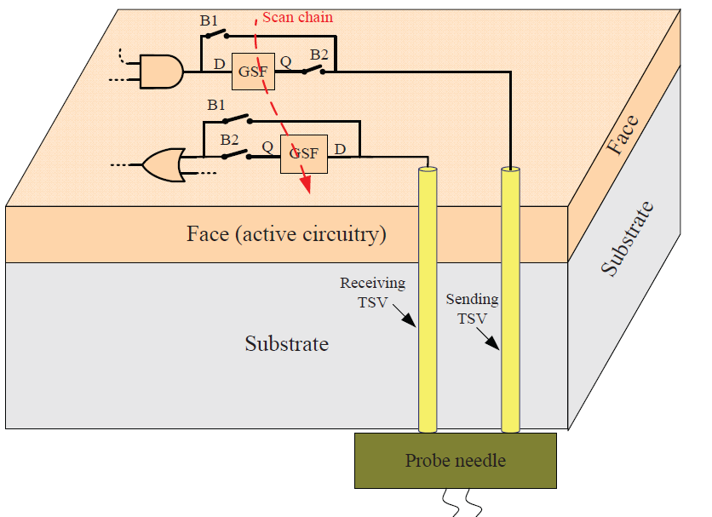
A novel TSV probing method
Illustration of pre-bond TSV probing on the
back side of wafer.

Slide 10
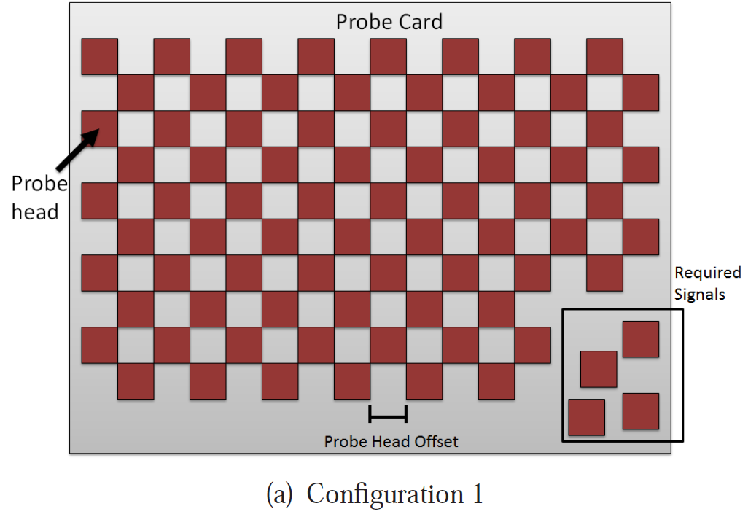
A novel TSV probing method
Probe card configuration 1
B. Noia and K. Chakrabarty, Design-for-Test and Test Optimization Techniques for TSV-based 3D Stacked ICs. Springer,
2014.

Slide 11
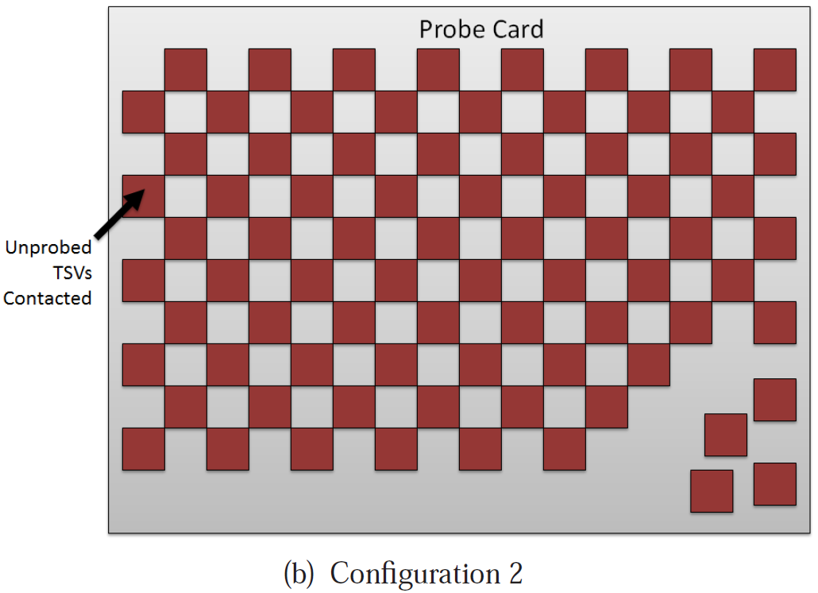
A novel TSV probing method
Probe card configuration 2
B. Noia and K. Chakrabarty, Design-for-Test and Test Optimization Techniques for TSV-based 3D Stacked ICs. Springer,
2014.

Slide 12
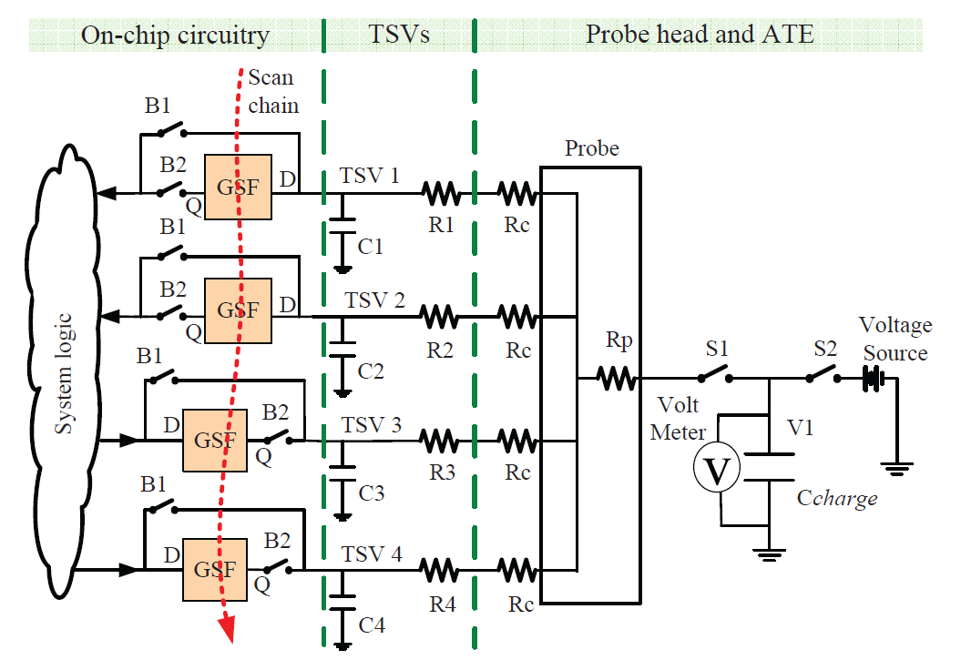
A novel TSV probing method
Circuit model of pre-bond TSV probing

Slide 13
Test time of parallel TSV test
Number of TSVs tested in parallel (q) | Capacitor charging time t(q) (10⁻⁷s)
1 | 8.0
2 | 5.3
3 | 4.2
4 | 3.8
1) Any faulty TSV within a parallel test will cause the test to fail but we cannot tell which TSV(s) is (are) faulty.
2) On the other hand, a good parallel test implies that all TSVs within the parallel test are fault-free.
S. K. Roy, S. Chatterjee, C. Giri, and H. Rahaman, “Faulty TSVs Identiﬁcation and Recovery in 3D Stacked ICs During
Pre-bond Testing,” in Proc. International 3D Systems Integration Conference, 2013, pp. 1–6.

Slide 14
Terminologies
TSV network | Formed by all TSVs simultaneously contacted to the same probe needle.
Test session (S_{i}) | TSVs tested in parallel within the same TSV network form a test session.
Maximum number of faulty TSVs to identify | This number m equals to the number of redundant TSVs in the TSV network being tested.
Session size (q) | Session size q is deﬁned as the number of TSVs within a session.
Resolution constraint (r) | Resolution constraint r indicates that the session size should never exceed r.
Test time of a session (t(q)) | It only refers to the charging time of C_{charge}, and is related to session size
Fault map (ρ) | Fault map represents positions of all defective TSVs within the TSV network.
Worst fault map | Worst faulty map for a given TSV network refers to a fault map which takes most sessions to identify.

Slide 15
Introduction
Why compound yield loss in W2W stacking?

Slide 16
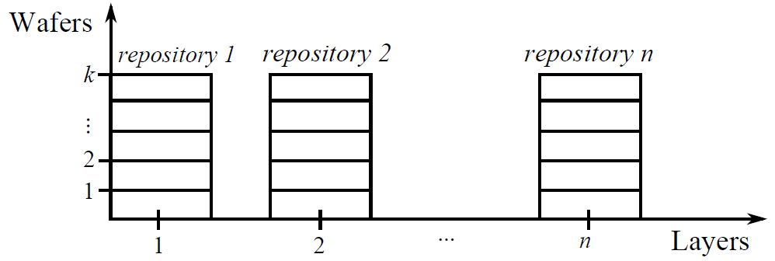
Introduction
Wafers versus Layers in 3D W2W stacking
M. Taouil, S. Hamdioui, J. Verbree, and E. Marinissen, “On Maximizing the compound yield for 3D wafer-to-wafer stacked IC," in Proc. International Test Conf., 2010, pp. 1-10.

Slide 17
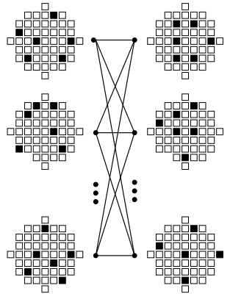
Matching Algorithms
Matching algorithms based on Static repository:
  Globally greedy matching
  Iterative matching heuristic
  Integer linear programming
  Iterative greedy
S. Reda, G. Smith, and L. Smith, “Maximizing the Functional Yield of Wafer-to-Wafer 3-D Integration,” IEEE Transactions on Very Large Scale Integration (VLSI) Systems, vol. 17, no. 9, pp. 1357–1362, Sept. 2009.

Slide 18
Presentation Outline
Introduction
Problem Statements
Prebond TSV test optimization
  Test session generation
  Dynamically identify faulty TSVs
  Test session scheduling
  Three-step test time optimization
Wafer-on-wafer stacking yield improvement and cost reduction
Conclusion

Slide 19
Problem Statement
General Problem 1
    How to quickly finish pre-bond TSV probing test.
    Pinpoint each defective TSV within a reparable TSV
    network (# faulty TSVs <= # redundant TSVs) as soon as possible.
    2) Identify an irreparable TSV network
    (# faulty TSVs > # redundant TSVs)
    as soon as possible.
General Problem 2
    How to improve the overall compound yield and
    reduce the cost of wafer-on-wafer stacked 3D ICs.

Slide 20
Presentation Outline
Introduction
Problem Statements
Prebond TSV test optimization
  Test session generation
  Dynamically identify faulty TSVs
  Test session scheduling
  Three-step test time optimization
Wafer-on-wafer stacking yield improvement and cost reduction
Conclusion

Slide 21
Test Session Generation
Motivation
Compared to individual TSV test, large test time saving is possible if we test TSVs in parallel without losing the capability of identifying up to m faulty TSVs, and also guarantee the size of each test session does not exceed the resolution constraint r.

Slide 22
Test Session Generation
Problem statement
Given the test time t(q) for different session size q (q∈[1, r]), given the maximum number (m) of faulty TSVs within a T TSV network. Determine a series of test sessions (with size less than r) so that up to m faulty TSVs can be uniquely identiﬁed and the total test time is minimized.
Sufficient condition solving the problem
If each TSV (TSV_{i}) is put in m + 1 sessions (say, S₁, S₂, · · · , S_{m+1}) and the intersection of any 2 out of these m + 1 sessions contains only TSV_{i}, i.e., S_{i} ∩ S_{j} = TSV_{i} for i ≠ j ∈ [1, m + 1], then up to m faulty TSVs within the network can be uniquely identified.
B. Noia and K. Chakrabarty, “Identiﬁcation of Defective TSVs in Pre-Bond Testing of 3D ICs,” in Proc. 20th AsianTest Symposium (ATS), 2011, pp. 187–194.

Slide 23
Limitations of previous heuristic method
For session generation
For example, to pinpoint 1 faulty TSV in a 6-TSV network with minimum resolution constraint of r = 4, the heuristic based sessions are
    {1,2,3,4}, {1,5,6}, {2,5}, {3,6}, {4}.
    Careful examination shows:
    Last session {4} is useless as the ﬁrst 4 sessions uniquely identify any single faulty TSV.
    After removing {4}, the remaining sessions are still not optimal as an optimal result is {1,2,3}, {1,4,5}, {2,4,6}, {3,5,6}, which further reduces test time by 9.7%.
B. Zhang and V. D. Agrawal, “Diagnostic Tests for Pre-Bond TSV,” to appear in Proc. 26th International Conference on VLSI Design, Jan 2015..

Slide 24
ILP based Session Generation
Three general constraints for our ILP model (named ILP model 1):
C1. Each TSV should reside in at least m + 1 test sessions.
C2. The size of a test session ranges anywhere from 0
(empty session) to r.
C3. Any non-empty session is supposed to be a unique
session for any TSV within it.
A unique test session for TSV_{i} is a session whose intersection with any other session containing TSV_{i} consists of only TSV_{i}.

Slide 25
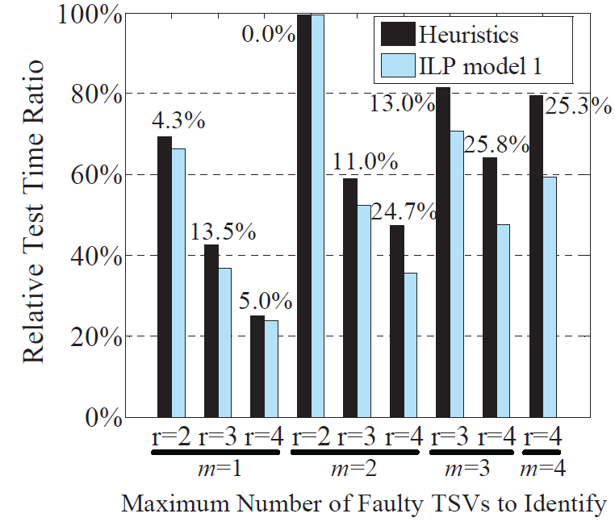
Experimental results
Test time comparison for a 20-TSV network
Notes:
Thus, wafers from the ﬁrst two repositories are matched without any restriction, and the pair producing maximum yield is selected (best-pair match). Then the pair of wafers as
a whole is matched with every wafer from the next repository to ﬁnd the best one (best-one match), and the same process iterates until the last repository. After one complete stack
is formed, each repository is replenished immediately. This process is repeated until the production size is reached.

Slide 26
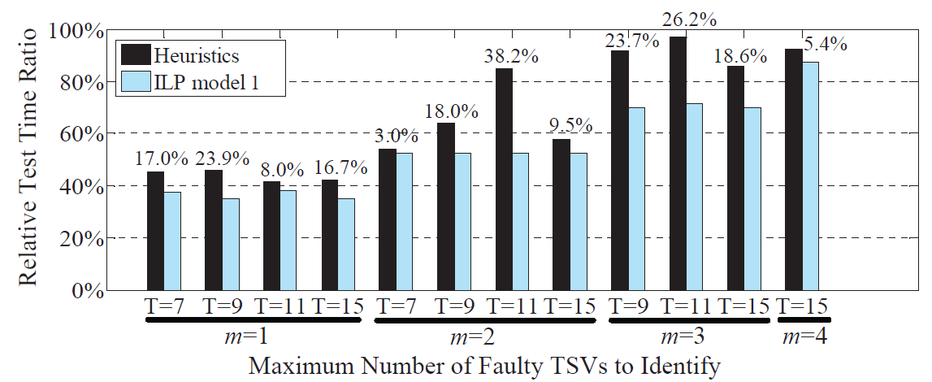
Experimental results
Test time comparison for resolution constraint r = 3
Notes:
Thus, wafers from the ﬁrst two repositories are matched without any restriction, and the pair producing maximum yield is selected (best-pair match). Then the pair of wafers as
a whole is matched with every wafer from the next repository to ﬁnd the best one (best-one match), and the same process iterates until the last repository. After one complete stack
is formed, each repository is replenished immediately. This process is repeated until the production size is reached.

Slide 27
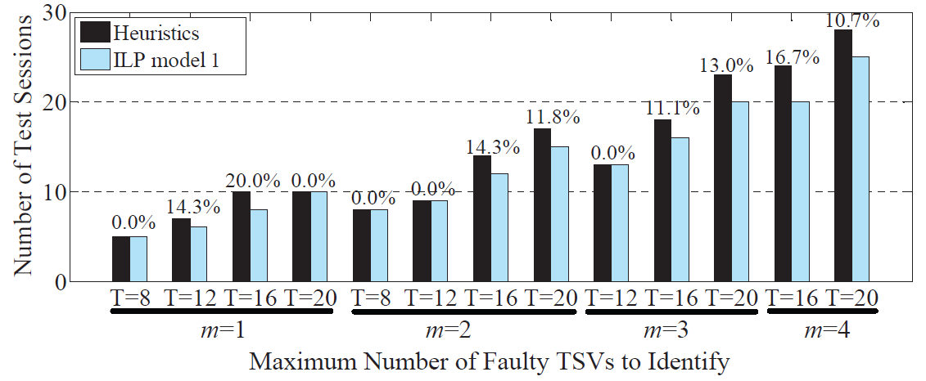
Experimental results
Comparison of number of sessions for r = 4
Notes:
Thus, wafers from the ﬁrst two repositories are matched without any restriction, and the pair producing maximum yield is selected (best-pair match). Then the pair of wafers as
a whole is matched with every wafer from the next repository to ﬁnd the best one (best-one match), and the same process iterates until the last repository. After one complete stack
is formed, each repository is replenished immediately. This process is repeated until the production size is reached.

Slide 28
Presentation Outline
Introduction
Problem Statements
Prebond TSV test optimization
  Test session generation
  Dynamically identify faulty TSVs
  Test session scheduling
  Three-step test time optimization
Wafer-on-wafer stacking yield improvement and cost reduction
Conclusion

Slide 29
Dynamically identify faulty TSVs
Motivation
To pinpoint 1 faulty TSV in a 6-TSV network with minimum resolution constraint of r = 4. Optimal sessions are
{1,2,3}, {1,4,5}, {2,4,6}, {3,5,6}
If TSV₁ is faulty, all 4 sessions need to be tested to identify it.
If TSV₆ is faulty, only the ﬁrst 3 sessions need to be tested to
pinpoint it.
3) Develop an algorithm to terminate the test as soon as our goal of identiﬁcation is reached.

Slide 30
Dynamically identify faulty TSVs
Problem statement
Given a series of test sessions, how to identify up to m faulty TSVs within a T-TSV network based on these sessions with minimum identification time.
Solutions:
First, during the identiﬁcation process, any “currently unnecessary” session is skipped.
Second, TSV test is terminated as soon as either all TSVs have been identiﬁed or the number of identiﬁed faulty TSV exceeds m.
B. Zhang and V. D. Agrawal, “An Optimal Probing Method of Pre-Bond TSV Fault Identiﬁcation for 3D Stacked ICs,” to appear in Proc. IEEE SOI-3D-Subthreshold Microelectronics Technology Uniﬁed Conference, Oct 2014.

Slide 31
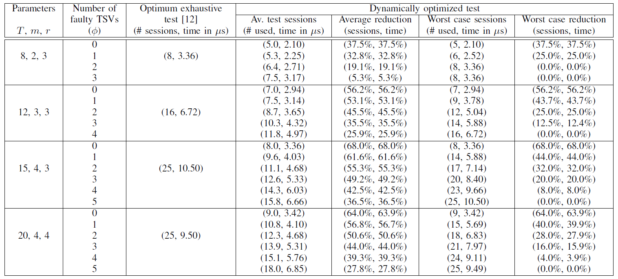
Experimental results
Exhaustive and dynamically optimized application of TSV test sessions constructed by ILP model 1
Notes:
Thus, wafers from the ﬁrst two repositories are matched without any restriction, and the pair producing maximum yield is selected (best-pair match). Then the pair of wafers as
a whole is matched with every wafer from the next repository to ﬁnd the best one (best-one match), and the same process iterates until the last repository. After one complete stack
is formed, each repository is replenished immediately. This process is repeated until the production size is reached.

Slide 32
Presentation Outline
Introduction
Problem Statements
Prebond TSV test optimization
  Test session generation
  Dynamically identify faulty TSVs
  Test session scheduling
  Three-step test time optimization
Wafer-on-wafer stacking yield improvement and cost reduction
Conclusion

Slide 33
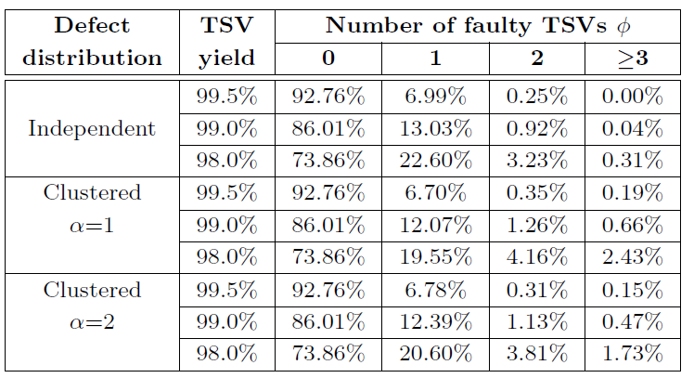
Test Session Scheduling
Motivation 1
In real silicon, TSV yield is expected to be more than
99% . It is most likely there is less than 1 faulty TSV within a TSV network.
Probability of different number of failing TSVs within a 15-TSV network

Slide 34
Test Session Scheduling
Motivation 2
In case of all TSVs within a network are fault free, all TSVs are identified as good TSVs as long as the already tested sessions covered all TSVs.

Slide 35

Test Session Scheduling
Problem statement
Given a series of N test sessions that can uniquely identify up to m faulty TSVs within a TSV network of T TSVs, ﬁnd an optimal order to apply those sessions so that the expectation of pre-bond TSV test time is minimized for this TSV network.
Test time expectation:

Slide 36
Test Session Scheduling
A simplified problem
Given N test sessions that can uniquely identify up to m faulty TSVs within a network of T TSVs, select M out of N sessions such that these M sessions cover each TSV at least once and the total test time of the selected M sessions is minimum.
This problem can be easily solved by constructing an ILP model (named ILP model 2).
B. Zhang and V. D. Agrawal, “An Optimized Diagnostic Procedure for Pre-Bond TSV Defects,” to appear in Proc. 32nd IEEE International Conference on Computer Design, Oct 2014.

Slide 37
Iterative session sorting procedure

Slide 38
Presentation Outline
Introduction
Problem Statements
Prebond TSV test optimization
  Test session generation
  Dynamically identify faulty TSVs
  Test session scheduling
  Three-step test time optimization
Wafer-on-wafer stacking yield improvement and cost reduction
Conclusion

Slide 39
Three-step Test Time Optimization
B. Zhang and V. D. Agrawal, “An Optimized Diagnostic Procedure for Pre-Bond TSV Defects,” to appear in Proc. 32nd IEEE International Conference on Computer Design, Oct 2014.

Slide 40
Two-step Test Time Optimization

Slide 41
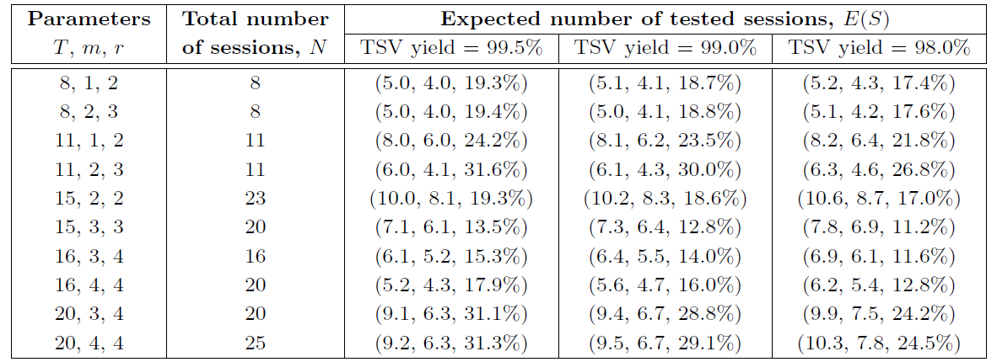
Experimental results
Expectation of number of tested sessions, defect clustering coefficient α = 1, data shows (sessions for SOS2, sessions for SOS3, reduction by SOS3)
Notes:
Thus, wafers from the ﬁrst two repositories are matched without any restriction, and the pair producing maximum yield is selected (best-pair match). Then the pair of wafers as
a whole is matched with every wafer from the next repository to ﬁnd the best one (best-one match), and the same process iterates until the last repository. After one complete stack
is formed, each repository is replenished immediately. This process is repeated until the production size is reached.

Slide 42
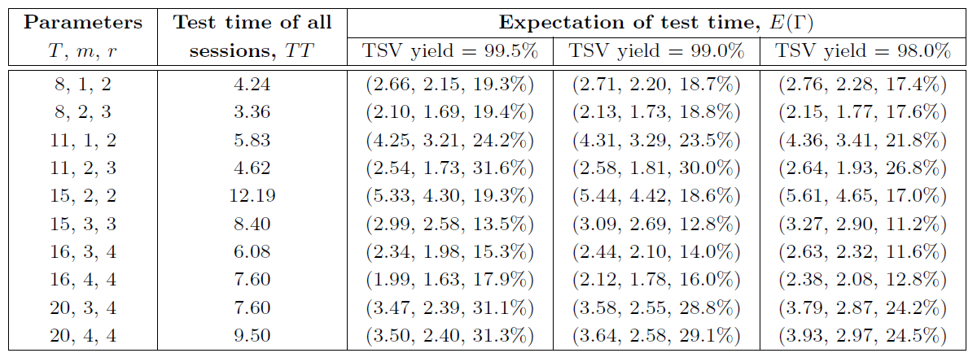
Experimental results
Expectation of test time (µs), defect clustering coefficient α = 1, data shows (test time for SOS2, test time for SOS3, reduction by SOS3)
Notes:
Thus, wafers from the ﬁrst two repositories are matched without any restriction, and the pair producing maximum yield is selected (best-pair match). Then the pair of wafers as
a whole is matched with every wafer from the next repository to ﬁnd the best one (best-one match), and the same process iterates until the last repository. After one complete stack
is formed, each repository is replenished immediately. This process is repeated until the production size is reached.

Slide 43
Presentation Outline
Introduction
Problem Statements
Prebond TSV test optimization
  Test session generation
  Dynamically identify faulty TSVs
  Test session scheduling
  Three-step test time optimization
Wafer-on-wafer stacking yield improvement and cost reduction
Conclusion

Slide 44
Illustration of Our Efforts
A new wafer manipulation method:
B. Zhang and V. D. Agrawal, “A Novel Wafer Manipulation Method for Yield Improvement and Cost Reduction of 3D Wafer-on-Wafer Stacked ICs,” Journal of Electronic Testing: Theory and Applications, vol. 30, pp. 57–75, 2014.
B. Zhang, B. Li, and V. D. Agrawal, “Yield Analysis of a Novel Wafer Manipulation Method in 3D Stacking,” in Proc. IEEE International 3D Systems Integration Conference, 2013, pp. 1–8.

Slide 45
Specifically Designed Wafers
Wafers fabricated with rotational symmetry:
Double rotation
Fourfold rotation
B. Zhang and V. D. Agrawal, “A Novel Wafer Manipulation Method for Yield Improvement and Cost Reduction of 3D Wafer-on-Wafer Stacked ICs,” Journal of Electronic Testing: Theory and Applications, vol. 30, pp. 57–75, 2014.
E. Singh, “Exploiting Rtational Symmetries for Improved Stacked Yields in W2W 3D-SICs,” in Proc. IEEE 29th VLSI Test Symposium (VTS), 2011, pp. 32–37.

Slide 46
Wafer Cut and Rotation
Cut rotationally symmetric wafer to sectors (subwafers):

Slide 47
Wafer Cut and Rotation
Sub-wafers rotation:

Slide 48
In case of more than 4 cuts, two methods of placement:
Placement method 1
Placement method 2

Slide 49
Wafer Cut and Rotation
Discussion on the number of cuts:
  Illustration of Die loss on a wafer
Places where no die can be placed

Slide 50
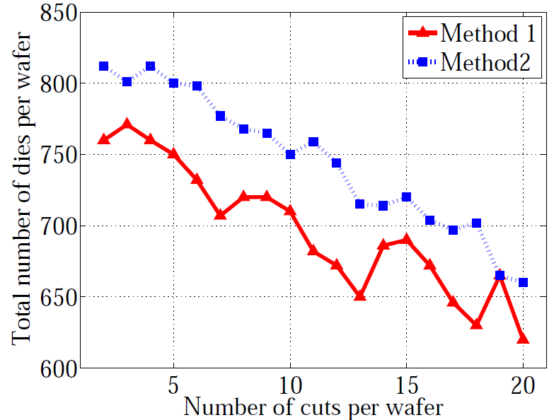
Relationship Between DPW and # of Cuts
# of dies per wafer:
Rule-of-thumb
In practice is 4-cuts
DPW V.S. number of cuts for placement method 1 and 2

Slide 51
Proposed wafer stacking Flow
Notes:
In Figure 7, initially all repositories are ﬁlled with subwafers. The best-pair match between the ﬁrst two repositories and the best-one match for the rest of the repositories are conducted afterwards. Consider for now that the matching is with respect to subwafers instead of wafers. For each repository replenishment,there is a back-up wafer which is cut and rotated. As one
subwafer leaves a repository, a new subwafer from the back-up wafer will replenish the repository, immediately. Once the back-up wafer is used, a new back-up wafer will replace it.

Slide 52
Summary
Different wafer manipulation methods:
Names | Explanations
Basic | Two wafers are matched directly
Rotation4 | Two wafers can be matched in 4 different ways due to rotational symmetry
Rotation2 | Two wafers can be matched in 2 different ways due to rotational symmetry
Cut and Rotation4 (CR4) | Each wafer is cut to 4 sectors and with each sector rotated for matching
Cut and Rotation2 (CR2) | Each wafer is cut to 2 sectors and with each sector rotated for matching

Slide 53
Experiments
Wafer with edge
clearance
Experiment setup:
We consider 200-mm wafers with
edge clearance set as 5 mm.
Die area
A production size of 100,000 3D ICs is targeted in
all experiments for each type of chips.
The running repository based best-pair matching algorithm
is utilized in the experiment.

Slide 54
Defect Models
G. DeNicoao, E. Pasquinetti, G. Miraglia, and F. Piccinini, “Unsupervised spatial pattern classiﬁcation of electrical fail-ures in semiconductor manufacturing,” in Artif. Neural Net-works Pattern Recognit. Workshop, 2003, pp. 125–131.

Slide 55
Yield Comparison Between Different Stacking Procedures
(a) Pattern 1
(b) Pattern 2
(c) Pattern 3
(d) Pattern 4
(e) Pattern 5
(f) Pattern 6
(g) Pattern 7
(h) Pattern 8
(i) Pattern 9

Slide 56
Impact of Number of Stacked Layers on Compound Yield
(a) Pattern 1
(b) Pattern 2
(c) Pattern 3
(d) Pattern 4
(e) Pattern 5
(f) Pattern 6
(g) Pattern 7
(h) Pattern 8
56
(i) Pattern 9

Slide 57


Cost Analysis Model

Slide 58
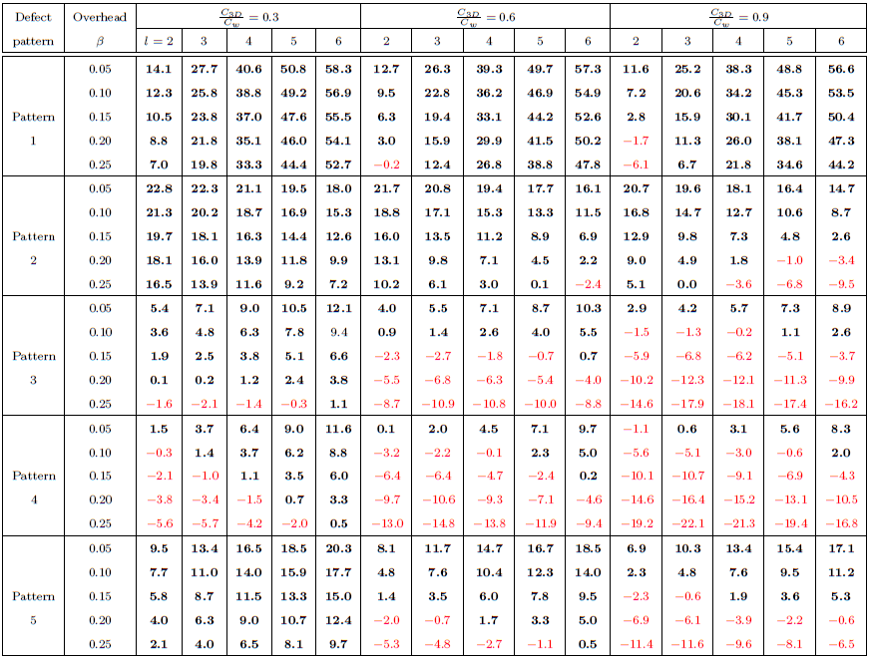
Cost improvement percentage for SSC4 over basic under various defect distributions and for number of staking layers (l) ranging from 2 to 6

Slide 59
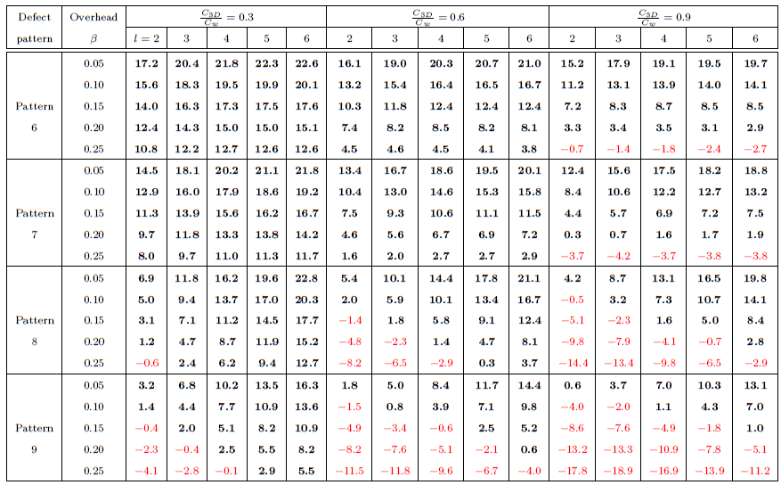
Cost improvement percentage for SSC4 over basic under various defect distributions and for number of staking layers (l) ranging from 2 to 6

Slide 60
Presentation Outline
Introduction
Problem Statements
Prebond TSV test optimization
  Test session generation
  Dynamically identify faulty TSVs
  Test session scheduling
  Three-step test time optimization
Wafer-on-wafer stacking yield improvement and cost reduction
Conclusion

Slide 61
Conclusion
Proposed three-step optimization for pre-bond TSV test
  Test session generation
  Dynamically identify faulty TSVs
  Test session scheduling
Proposed wafer Cut and Rotation manipulation method for yield improvement and cost reduction of wafer-on-wafer stacked ICs

Slide 62
Journal and Conference presentations
B. Zhang and V. D. Agrawal, “SOS3: Three Step Optimization of Pre-bond Defective TSV Diagnosis,” (14 pages, in preparation) in Journal of Electronic Testing: Theory and Applications.
Y. Zhang, B. Zhang and V. D. Agrawal, “Diagnostic Test Generation for Transition Delay Faults Using Stuck-at Fault Detection Tools,” (18 pages, minor revision) in Journal of Electronic Testing: Theory and Applications.
B. Zhang and V. D. Agrawal, “An Optimal Probing Method of Pre-Bond TSV Fault Identiﬁcation for 3D Stacked ICs,” to appear in Proc. IEEE SOI-3D-Subthreshold Microelectronics Technology Uniﬁed Conference, Oct 2014.
B. Zhang and V. D. Agrawal, “An Optimized Diagnostic Procedure for Pre-Bond TSV Defects,” to appear in Proc. 32nd IEEE International Conference on Computer Design, Oct 2014.
B. Zhang and V. D. Agrawal, “Diagnostic Tests for Pre-Bond TSV,” to appear in Proc. 26th International Conference on VLSI Design, Jan 2015.
B. Zhang and V. D. Agrawal, “A Novel Wafer Manipulation Method for Yield Improvement and Cost Reduction of 3D Wafer-on-Wafer Stacked ICs,” Journal of Electronic Testing: Theory and Applications, vol. 30, pp. 57–75, 2014.
B. Zhang, B. Li, and V. D. Agrawal, “Yield Analysis of a Novel Wafer Manipulation Method in 3D Stacking,” in Proc. IEEE International 3D Systems Integration Conference, 2013, pp. 1–8.

Slide 63
Thank you!

